Slide 1
Publishers and Bing Ads Network

Slide 2
Overview
Publisher Overview
Publisher Ad Units
Publisher Hierarchy
Smart Pricing
Overview
Benefits
Publisher Quality Metrics
Cost per acquisition Index (CPAi)
Publisher Traffic Quality Score (PTQS)
Network Distribution
Process Flow: From User Query to Publishing Search Results
Entry Point
Form Codes
Form Code Taxonomy
Organic and Inorganic Searches
Appendix
Notes:
Publisher : An individual or organization that prepares, issues or disseminates (spreads widely) content for public distribution or sale via one or more media.
The main aim of a publisher is to get more traffic on their web page. The platform shares a certain percentage of revenue that is generated via that publisher by means of users clicking on the ads displayed on its web page.
Example of Publisher : http://infospace.com/ (Bing Syndication Publisher)
Brands under Infospace : http://infospace.com/brands/ ( dogpile.com / webcrawler.com)

Slide 3
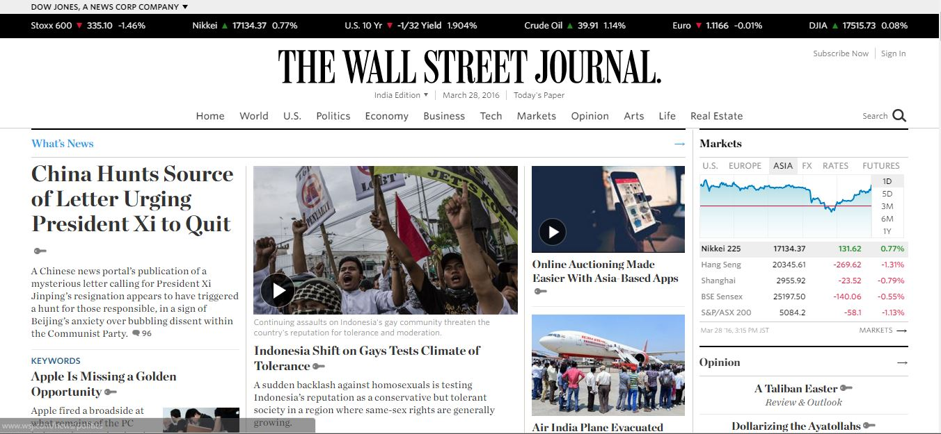
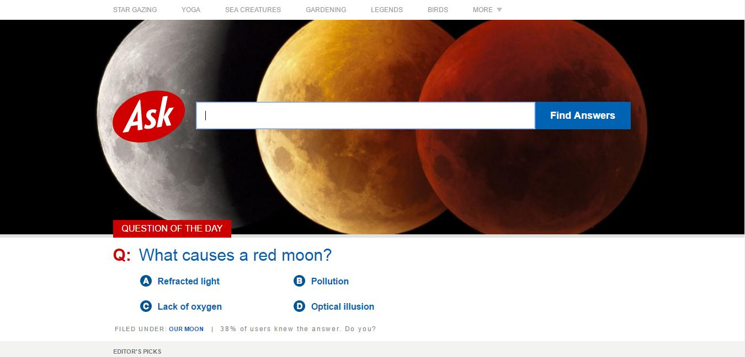
Publisher Overview
In Search Advertising, a Publisher is an entity that own one or more websites that display ads within their web content
The main aim of a publisher is to get more traffic on their enterprise web pages
Examples of Publishers: Bing.com, Ask.com
Examples :
Notes:
Publisher : An individual or organization that prepares, issues or disseminates (spreads widely) content for public distribution or sale via one or more media.
The main aim of a publisher is to get more traffic on their web page. The platform shares a certain percentage of revenue that is generated via that publisher by means of users clicking on the ads displayed on its web page.
Example of Publisher : http://infospace.com/ (Bing Syndication Publisher)
Brands under Infospace : http://infospace.com/brands/ ( dogpile.com / webcrawler.com)

Slide 4
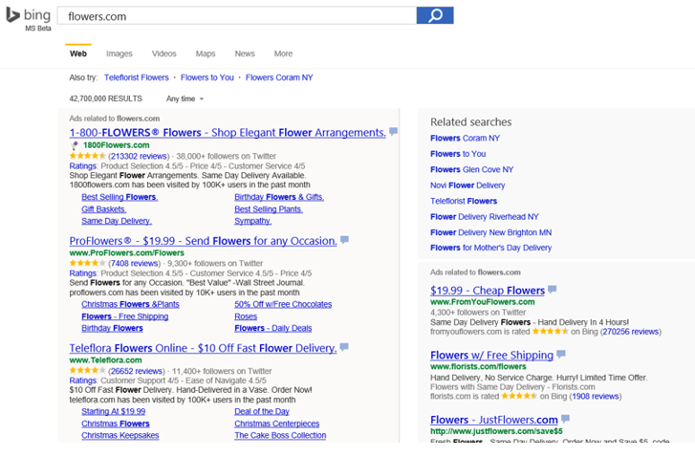
Publisher Ad Units
An Ad Unit is a space on a publisher’s web page where queries can be searched
A publisher page can have multiple Ad Units
Ad Unit ID
Notes:
Publisher with more than one adunit on its web page : http://www.aol.com/
* Algorithm results : non ad results

Slide 5
Publisher Hierarchy
Owned and Operated (O&O)
Publishers under O&O that are Owned and Operated by Bing Yahoo! Network
These ad units are known as O&O Core
E.g. Bing.com, MSN.com
Syndicated
Publishers not owned or operated by Bing or Yahoo! but display Bing Network ad results on their pages. Examples: Gumtree, Infospace
Note, there are some syndicated network partners who have O&O treatment for some of their Ad Units due to their high quality traffic such as AOL. These ad units are classified under O&O as O&O Rest
Ad unit
Bing or Yahoo!
O&O (Core & Rest)
Publisher A
Publisher B
Syndicated
Publisher C
Publisher D
Ad Unit 1
Ad Unit 2
Ad Unit 3
Ad Unit 4
Ad Unit 5
Ad Unit 6
Publisher
Marketplace
Network

Slide 6












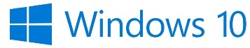



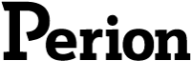

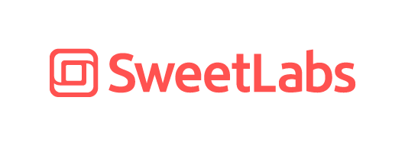

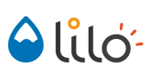




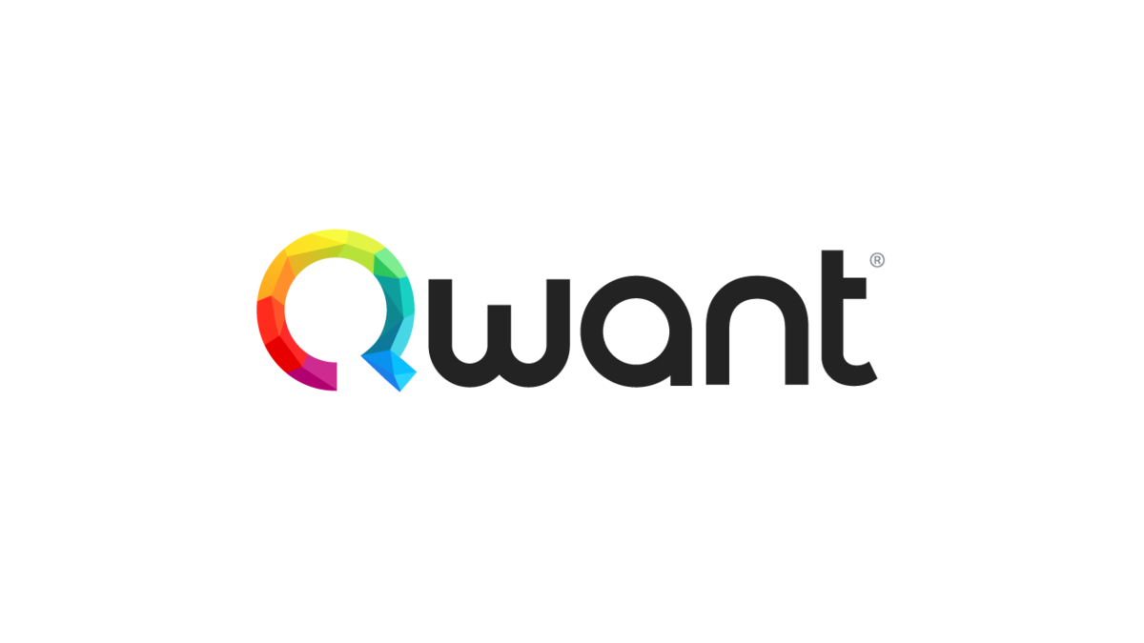




A growing network of high-quality partners
Apple
Bing Experience (Bing-owned properties and third-party distribution partners)
Third-party Publishers (syndication partners)
Microsoft Publishers

Slide 7
Publisher Traffic Quality Metric (PTQS)
What is Publisher Traffic Quality Score (PTQS)?
Publisher conversion quality score (ranging from 0.5 to 10) measured against selected O&O ad units conversions as a benchmark
Higher scores imply higher quality
Why PTQS?
Provide publishers visibility into their traffic quality
PTQS Calculation?
PTQS data is calculated at a publisher/ ad unit / type tag level
This score is based off a 28 day rolling period and is refreshed twice a week (Tuesday and Saturday).
Notes:
Sometimes PTQS value can show up as -1, this means for that corresponding publisher/ ad unit or type tag no PTQS data was available on that specific day.

Slide 8
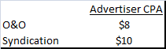
Publisher Quality Metrics - Cost per acquisition Index (CPAi)
What is CPAi?
Cost per acquisition Index (CPAi) is used to compare cost per acquisition of syndication publishers with that of the O&O publishers
Customers with zero conversions on the O&O Base or CPAi Partner Properties, conversion rates greater than 50% or clicks less than 40 are excluded
Why use CPAi?
Used for assessing the traffic quality of syndication publishers
CPAi also helps in determining the discounts (benefits) that publishers receive
Is necessary for a complete view of the marketplace
How is CPAi Calculated?
CPA = Cost per Acquisition i.e. Revenue / Conversion.
In other words, CPA of a publisher is the cost incurred by Bing Ads per conversion
CPAi = 0.8

Slide 9
CPAi Management
CPAi (Cost Per Acquisition Index)
Compares cost per acquisition on syndication to that of O&O
CPAi = CPA of the benchmark / CPA of that network
Smart Pricing
Dynamic discounting of publisher revenue and advertiser’s cost-per-click (CPC) depending on the quality of traffic
Platform tries to maintain the same cost per acquisition across different parts of network. To achieve this, the platform provides discounts in such a way that it will bring CPA close to the benchmark
CPAi is a network metric. Publishers don’t have a CPAi. This measure allows network management as an aggregate standard, in agreement with Yahoo!
Combined O&O
CPA* = $2.5
CPAi = 0.5
Syndication
CPA* = $5
A score of 1.0 would mean these are equal.
Notes:
CPAi (for the particular network ) = CPA of the benchmark / CPA of that network
So if we are calculating CPAi of Bing Syndication, then the formula for CPAi will be CPA of O&O / CPA of Syndication = $2.5/$5 = 0.5
*Case Scenario :
Syndication
Conversion = 4
Advertiser Spend = $ 20
CPA = $20/4 = $5
O&O Combined
Conversion = 8
Advertiser Spend = $ 20
CPA = $20/4 = $2.5

Slide 10
Smart Pricing Overview
What is Smart Pricing?
Smart Pricing (SP) is a discount given to advertisers for serving their ads on the syndication network. This discount is based on the quality of the publishers’ incoming traffic
There’s an inverse relation between Smart Pricing discount and quality of traffic. The higher the quality of traffic the lower the discount
This feature takes into account variable traffic quality and equalizes the cost of acquisition* of traffic for advertisers among all other network traffic sources. It is intended to be used to generate higher revenue for network partners who provide good quality traffic
*CPA = Cost per Acquisition i.e. Revenue/Conversions
Why Smart Pricing?
Protect advertisers Return on Investment (ROI)** relative to Bing Ads Network selected O&O ad units
Protect O&O and high-quality syndication publishers from price and revenue erosion due to lower quality publishers
How is Smart Pricing Applied?
Based on the quality on a publisher-ad unit, advertisers clicks get discounted to maintain advertiser ROI
Notes:
*Benchmark: Bing O&O Core
**Cost of acquisition:
Smart Pricing is about long-term marketplace health. It's a balance between Publisher Revenue and Advertiser ROI. There is no single solution that will make everyone happy
Smart Pricing is about equity: higher-quality publishers (i.e. those with higher conversion rates) generate greater value and therefore greater revenue per click
Smart Pricing is not a one-time, all-or-nothing decision. We can choose the degree of discounting proportionately to the conversion signal
**ROI = Return on Investment (Revenue - Cost of goods sold) / Cost of goods sold

Slide 11
Smart Pricing Benefits
For Publishers
Protect O&O and high-quality syndication publishers from price and revenue erosion due to lower-quality publishers
For Advertisers
Ensure that advertisers are not over paying for lower quality traffic
For Marketplace
Maintain sufficient quality to attract / retain advertisers and publishers
Avoid perceived value dilution
Notes:
*Benchmark: Bing O&O Core
**Cost of acquisition:
Smart Pricing is about long-term marketplace health. It's a balance between Publisher Revenue and Advertiser ROI. There is no single solution that will make everyone happy
Smart Pricing is about equity: higher-quality publishers (i.e. those with higher conversion rates) generate greater value and therefore greater revenue per click
Smart Pricing is not a one-time, all-or-nothing decision. We can choose the degree of discounting proportionately to the conversion signal

Slide 12
Network Distribution
What is Network Distribution?
Advertisers have the flexibility to target their campaigns on either O&O or Syndication or both based on their traffic preference
Why Network Distribution?
Advertisers express desire to have control over where their ads will be shown or rendered
How is Network Distribution Performed?
Advertisers have the ability to specify options to set the network distribution at Ad Group (Order Id) level
Notes:
# Domain block : Advertiser can stop their Ads to be displayed on a particular publisher website (i.e some specific URL) which means they can block the domains on which they don’t want their ads to come up. Domains can be blocked at campaign or order id level.
Advertisers at an ad group / order Id level can opt in or opt out of certain network slices.
Current opt in/ opt out options are :
YBN O&O and Syndication
YBN O&O
YBN Syndication

Slide 13
What is an Entry Point?
Entry Point refers to how a user gets to Bing Search Pages
Entry Point is defined at a session* level
* Session is defined as a series of interactions by the user toward addressing a single information need
Generally, Entry Point can be derived from the Form Code of the first page view in a session
Major Entry Points:
TB : Toolbar is for sessions where the first query came from either the Bing Search Bar, Windows Live Toolbar, or MSN Toolbar
IE : Represents sessions where the first query came from either the browser Search Box, or a query in the address bar
MSN : Represents sessions where the first query originated from any MSN property. This includes the search bar as well as the programmed query links inside news modules.
HomePage : Represents sessions where the first query originated www.bing.com (or the international equivalents)
Unknown : Represents sessions that began without a form code, and did not originate from a homepage. These are generally considered to be buggy records.
.
Notes:
*SessionId, a hash value is a unique id to help identify a user session. The Session Id expires on continued web search inactivity, or on closing Cortana

Slide 14
What is a FORM Code?
It is a unique 6 character alpha numeric code used primarily to track searches driven from any Entry Point
Appended to the URL in the source page as a query string parameter
Different types of FORM Codes
External : Used in traffic originating from a domain other than Bing such as MSN, IE, toolbar etc.
Internal : Used in traffic originating from within Bing and re-entering another part of Bing
Static – Fixed 6 character codes
Dynamic – May vary from 4 to 6 characters

Slide 15
FORM Code Taxonomy
A FORM Code is organized into a hierarchy of 3 levels
Entry Point of the Search
Vertical of the Source Page
Type of traffic conveyed by the link
3 Levels:
Example:
Level1 – Entry Point
Search
Level2 - Vertical
Web
Images
Travel
Level3 – Type of traffic
Requery
Navigation

Slide 16
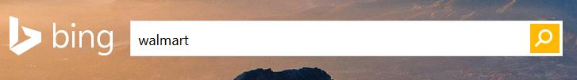
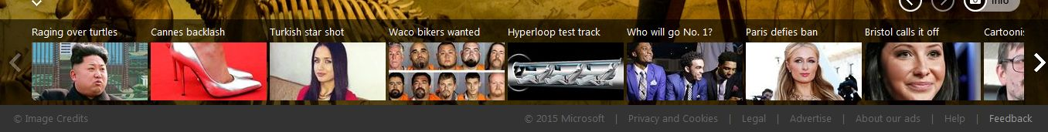
Organic and Inorganic Search
User typed searches are organic. Example: typing query in search bar
Artificially induced (programmed / editorial) searches are in-organic. Example: clicking on popular news item
While organic searches align with user intent, inorganic searches may or may not
4/10/2018 10:51:05 PM

Slide 17

Process Flow: From User Query to Publishing Search Results
Bing.com
QBLH
Organic
Ad-Unit ID
IE
PRUSEN
In-Organic
User Searches Query -
Entry Point
MSN
Organic
Form Code based on Different Entry Points
Results displayed at Publishers Websites
IE8SRC
Ad-Unit ID
User
In-Organic
Tool Bar
YHOOFP
Organic
Ad-Unit ID
Others
……..
In-Organic
Organic,
In Organic
17
Notes:
*SessionId, a hash value is a unique id to help identify a user session. The Session Id expires on continued web search inactivity, or on closing Cortana

Slide 18
APPENDIX

Slide 19
Factors Affecting KPI Movements In The Network
KPIs
Factors
CPCs drop
Coverage Issue
Tuning
ROI shift
Traffic Volume increases but not Revenue
Bot* traffic
Query Mix* changes
Coverage issue
Click Yield drops
Coverage Issue
Irrelevant
ads
Traffic Volume
drops
Coverage drops
Budget sufficiency
Churn
Tuning
MLIY drops
Tuning
Field
Engineering
Publisher(s)
Notes:
Bot - Simple computer program used to perform highly repetitive operations
Query Mix – Types of queries searched on a publisher website changes with time of the year and demographics
Tuning – Changes made by engineering team to improve the revenue or user experience e.g. Increasing/decreasing number of ads

Slide 20
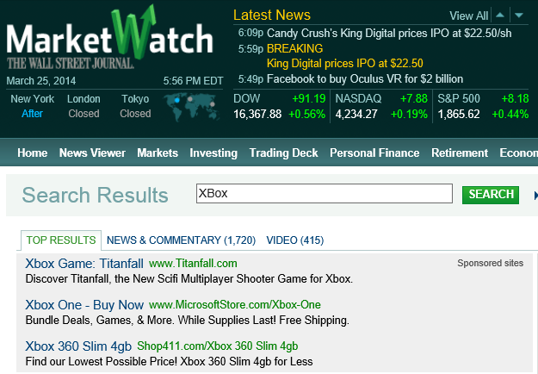
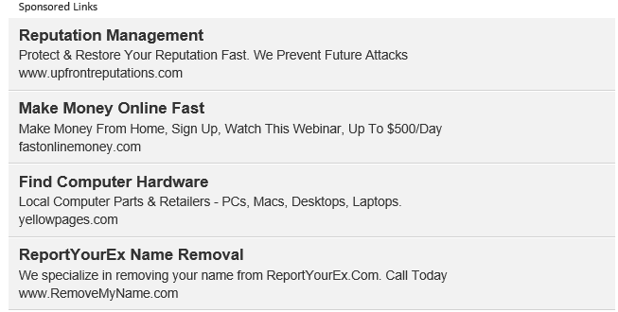
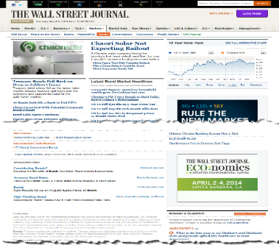
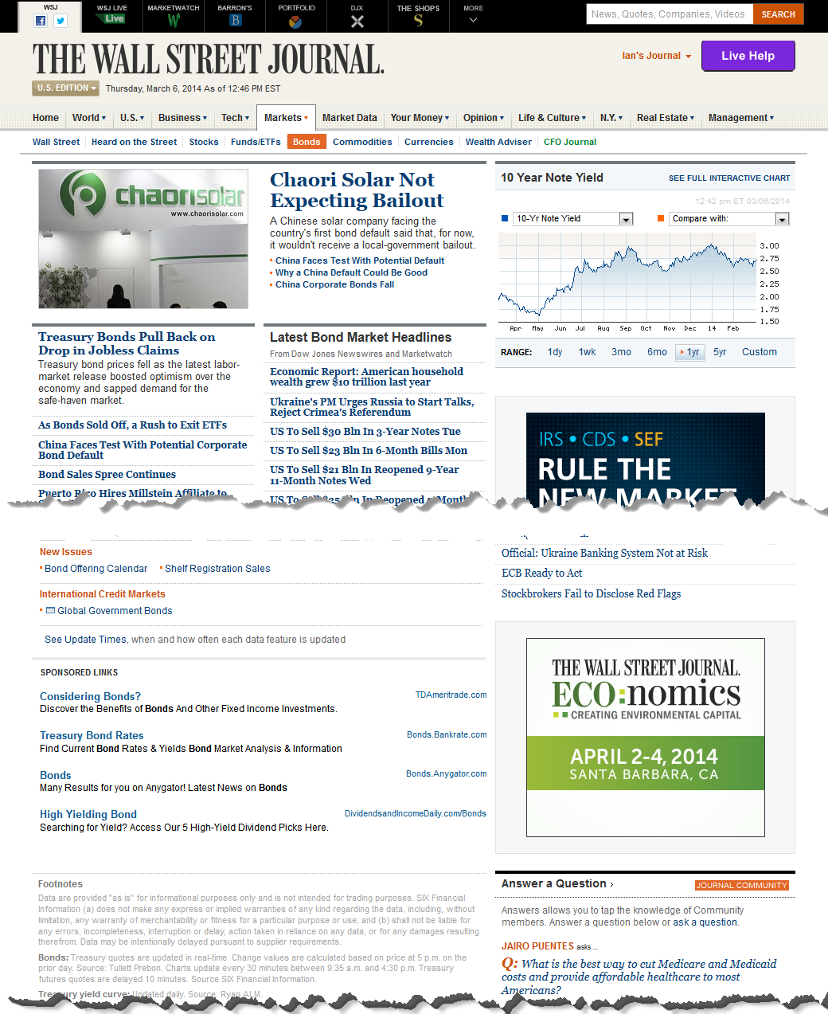
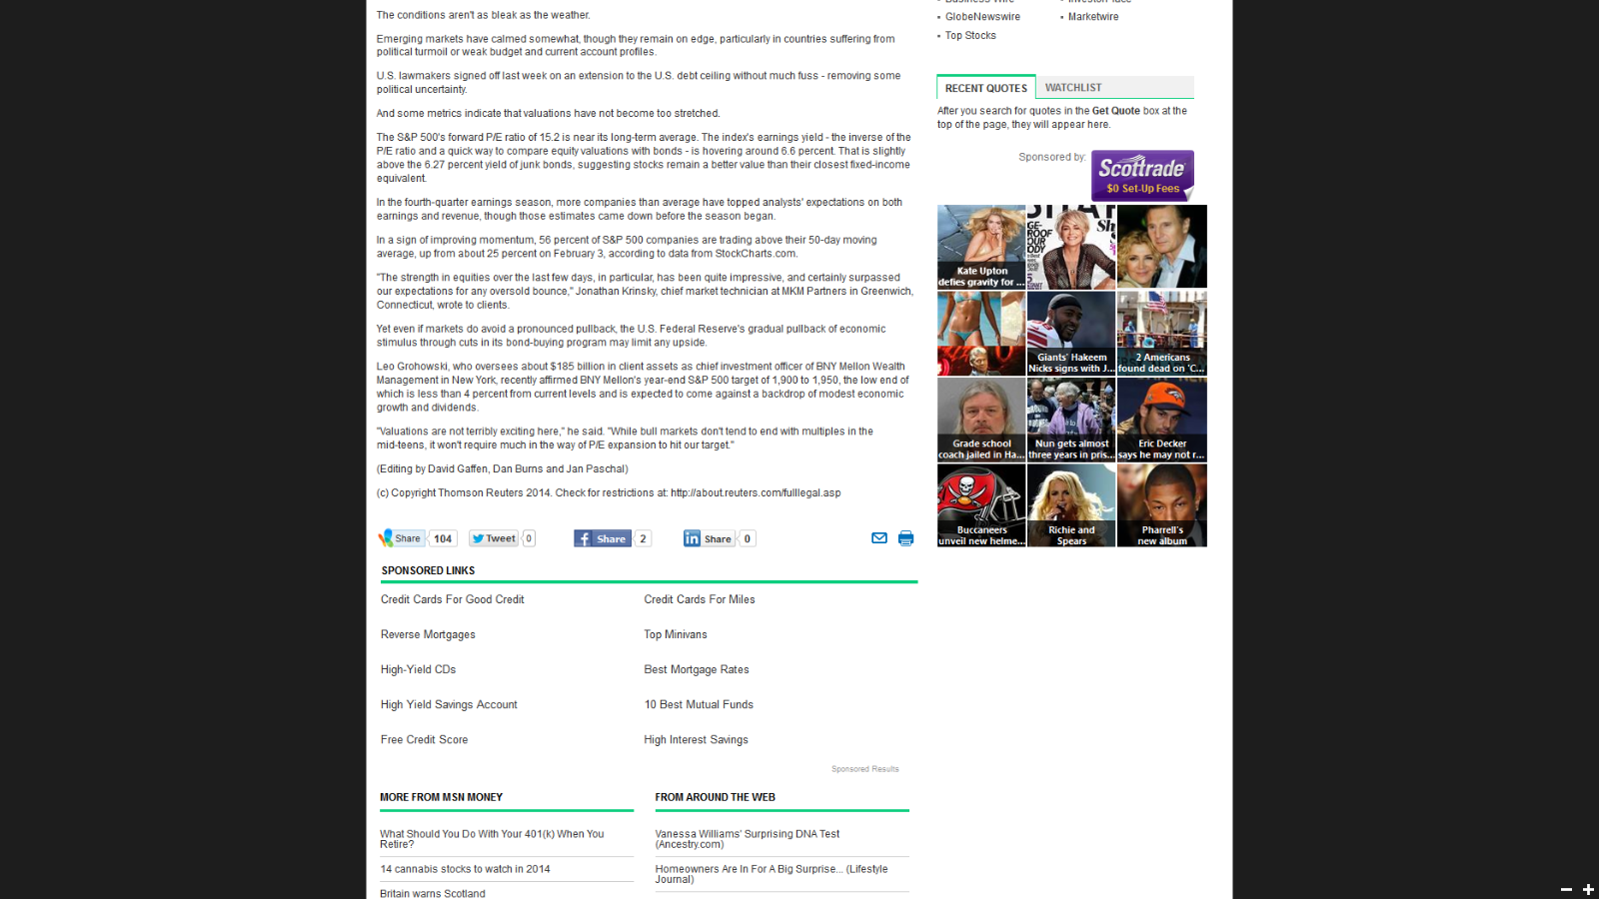
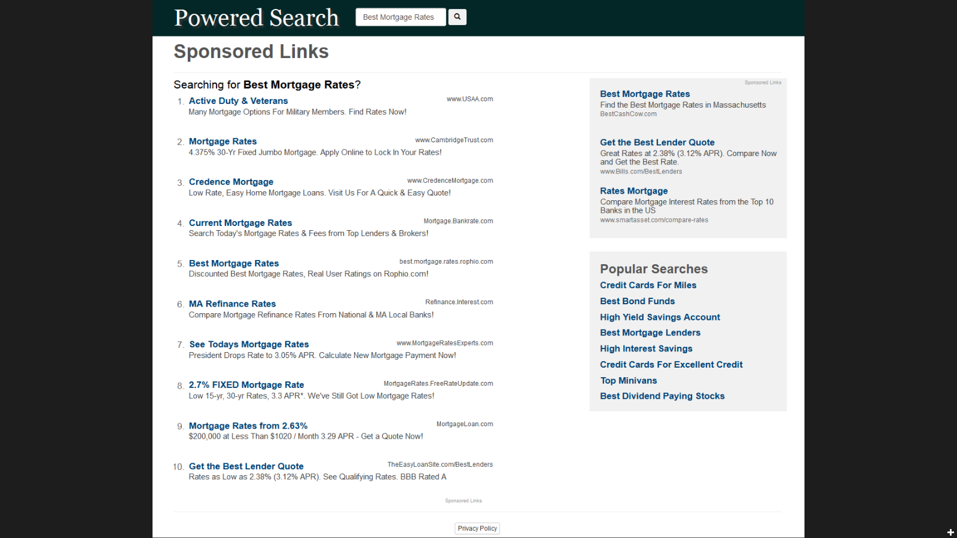
Bing Ads – Search Result Types
Paid Search
Paid advertisements mixed with organic search results on SERP
Contextual Search
Advertisements mixed with third-party web pages
One Click
All organic results obtained by searching on Yahoo Bing Network are one clicks
Two Click
The search results redirected to user on a publisher page after clicking on a link in Yahoo Bing Network

Slide 21
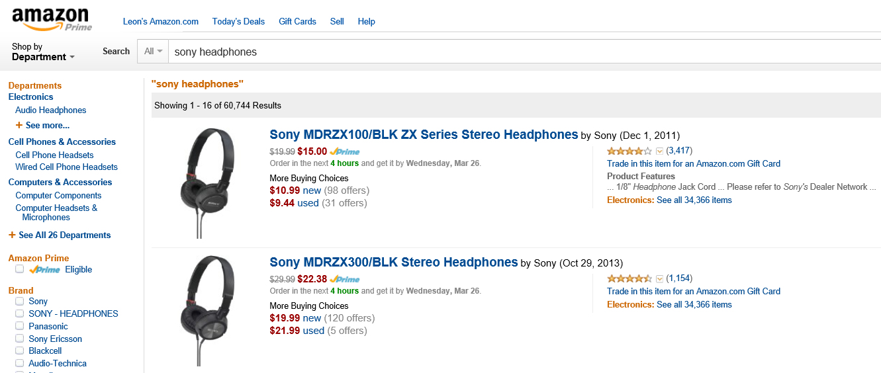
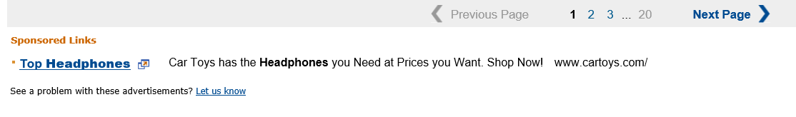
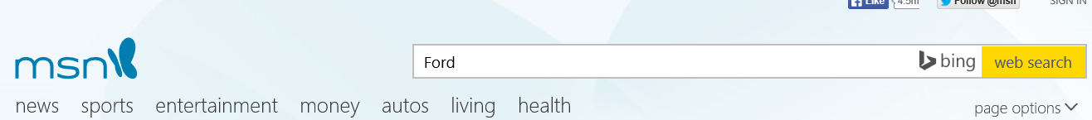
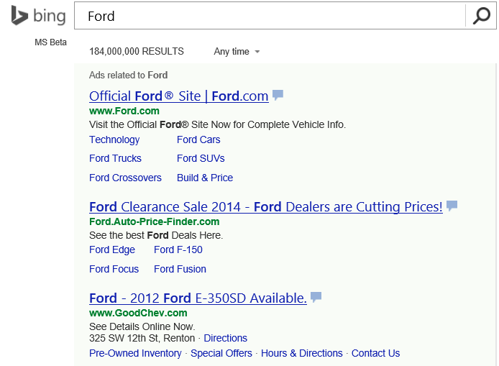
Bing Ads – Publisher Search Result Types
Publisher Hosted Ads Only
Ads are served on the publishers webpage based on a user’s search query
Redirect to Bing
Users are redirected to Bing following a web search on publisher’s webpage

Slide 22
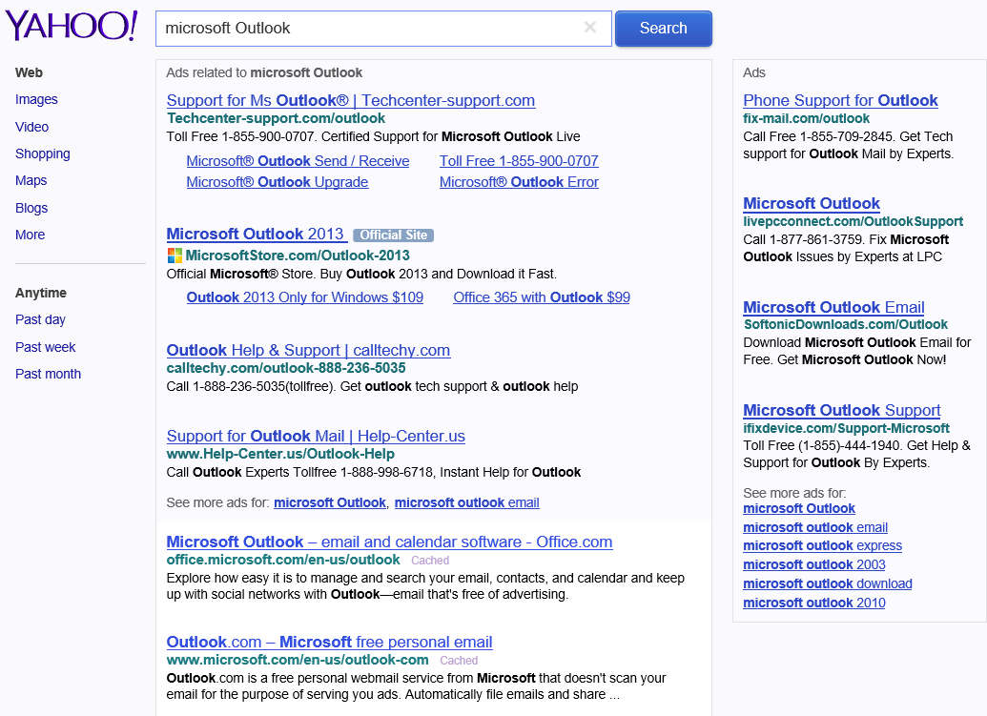
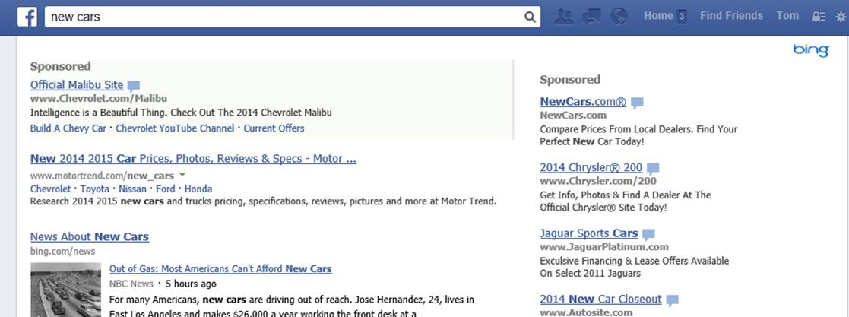
Bing Ad – Publisher Hosted Ads
Publisher Hosted Ads & Algo*
Publisher hosts Bing algorithmic results and paid search ads
Publisher Hosted Ads & Algo* Co-Branded
Publisher hosts Bing algorithmic results and paid search ads co-branded with Bing logo
Notes:
Algorithmic results : Search results shown to a user based on the user’s query. It excludes ads or other “additions” to the search results not driven exclusively by relevance to user queries

Slide 23
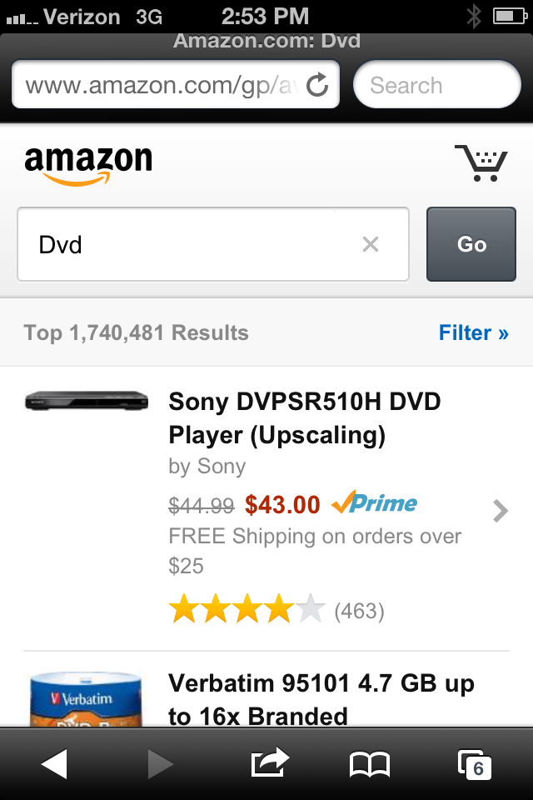
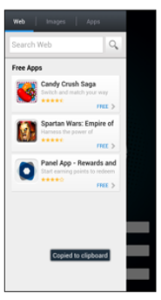
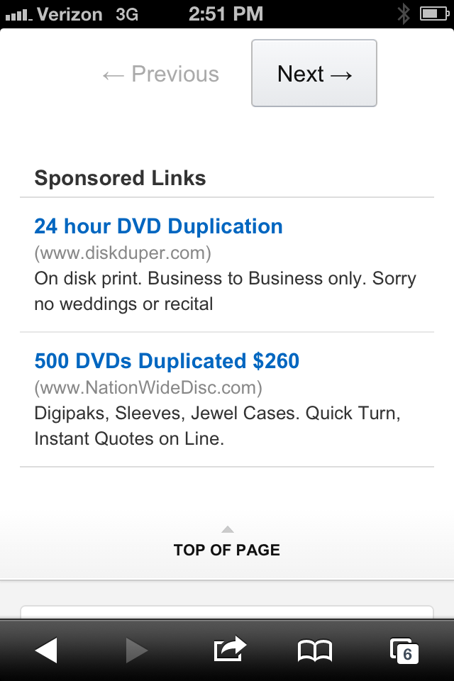
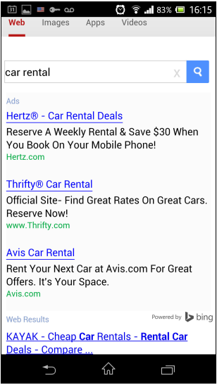
Paid Search Implementations - Mobile
PS on Mobile/ Tablet Web Site
Bing In-App with Redirect

Slide 24
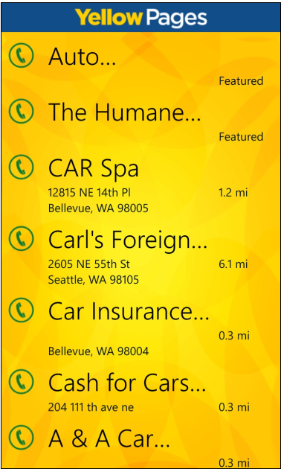
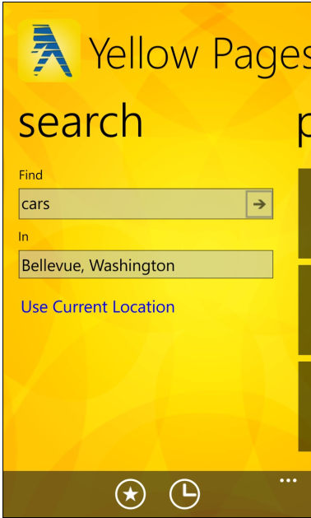
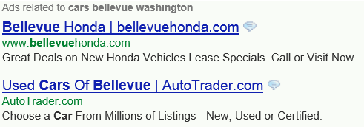
Paid Search Implementations – Mobile
In App Ads only Paid Search

Slide 25
One Click
How it works and is different than CX
Paid Search ads served based on users navigation (breadcrumbs)
Non traditional searches (stock quotes, product searches)
Prior search query
Where It Runs
In fixed placements on PC based publisher inventory
In unsold display inventory *
In unsold Ads in Apps (AiA) inventory *
What It Means
A new source of high quality ROI driving clicks for Bing Ads advertisers
A new monetization source for publishers that
combines the demand scale of Paid Search Advertising with the supply scale of Display

Slide 26
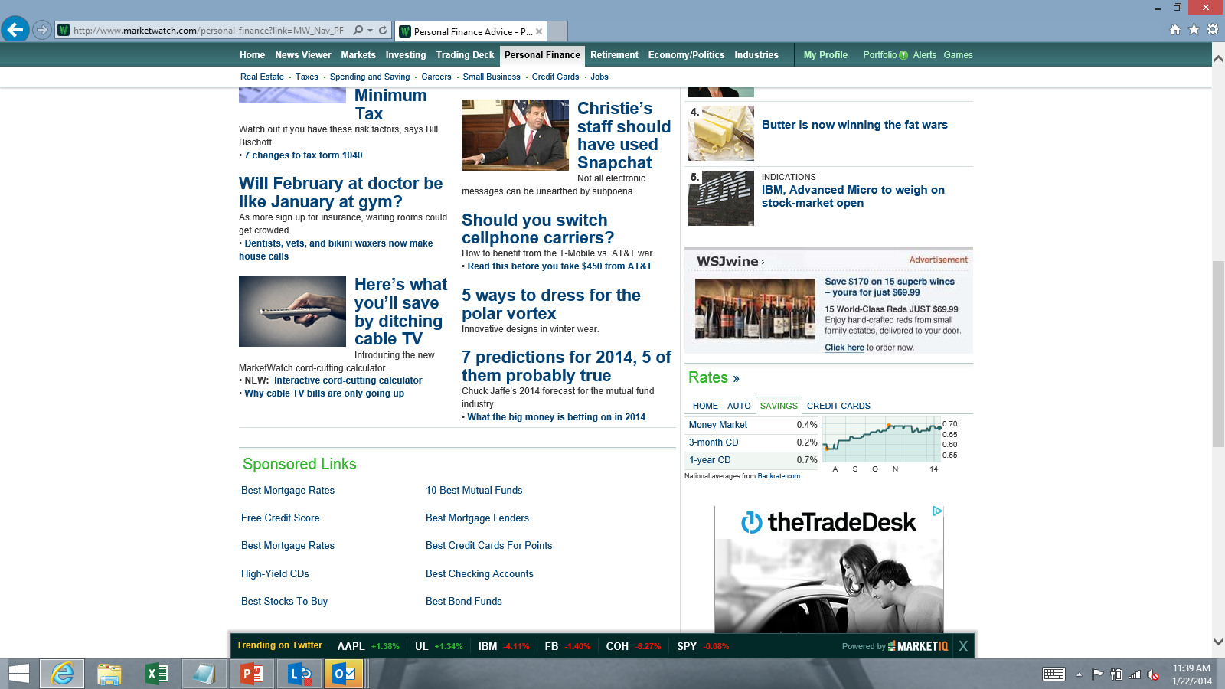
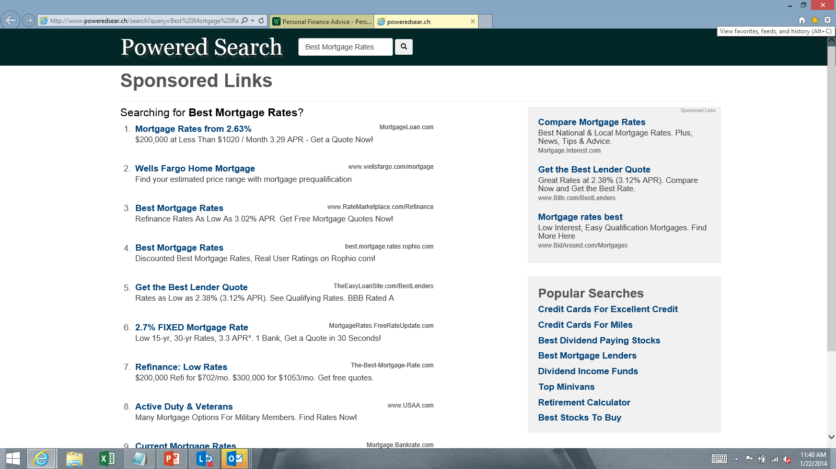
Two Click
How It Works
Contextually targeted keywords are served on publisher content pages
Clicking on a keyword triggers a search and brings a user to a search results page populated with Paid Search Ads from Bing Ads
Where It Runs
In fixed placements on PC based publisher inventory
In unsold display inventory *
In unsold AiA inventory *
What It Means
A new source of high quality ROI driving clicks for Bing Ads advertisers
A new monetization source for publishers that combines the
demand scale of Paid Search Advertising with the supply scale of Display
Next Steps
Plan to test performance across various 2-click providers
Chitika
Netseer
Media.net
Test providers by rotating on same inventory using ad server (AppNexus)
Screenshots from third party partner site MarketWatch.com

Slide 27

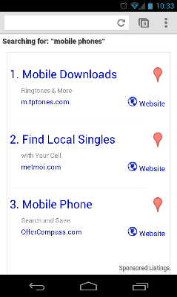
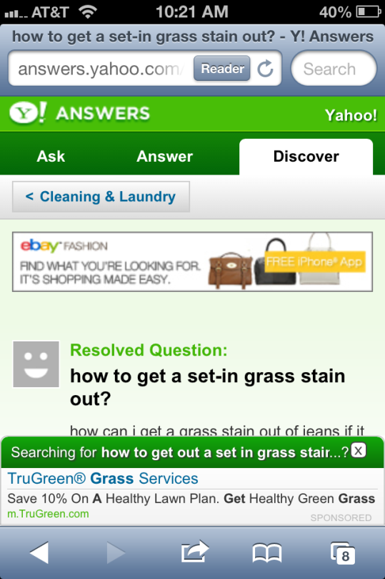
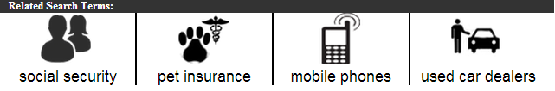
Two Click – Mobile Web

Slide 28
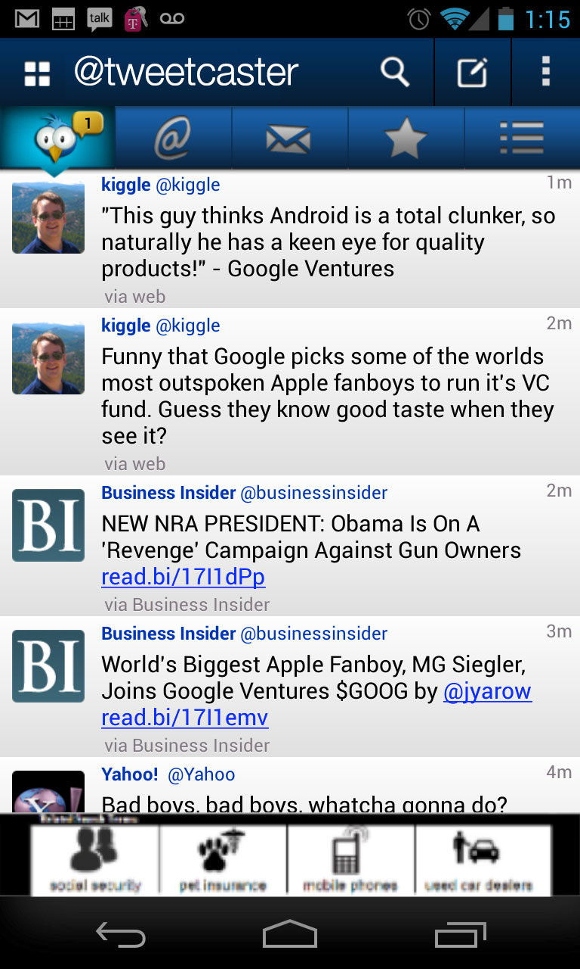
Two Click In-App

Slide 29
Syndication-Related Products
Description
Dynamic discounting of publisher revenue and advertiser’s cost-per-click (CPC) depending on the quality of traffic (i.e. conversion performance) relative to a pre-defined benchmark
Triggers from “CPAi” – Cost Per Acquisition Index”- which compares conversion rates on syndication to those on O&O. A score of 1.0 would mean these are equal.
Smart Pricing
A traffic quality metric (ranging from 0.5 to 10) which is exposed externally to Syndication partners.
Correlates to Smart Pricing discount.
PTQS
Ability for advertisers to opt in or out of different network traffic types. Current options (at order level) include:
Bing & Yahoo O&O + Syndication
Only Bing & Yahoo O&O
Only Bing & Yahoo Syndication
Network Distribution

Slide 30
Factors to Consider: Smartpricing Market Strategy
In establishing the mix of levers/operating point, Yahoo! and Microsoft Teams meet to discuss Marketplace dynamics. Discussions generally include the following data and considerations:
Inputs into Quality Based Pricing Decisioning | Ongoing Watch Points
Combined Market Share Only markets of a sufficient size warrant active management Relative Share of O&O to Syndication O&O revenue needs protection. Markets with low syndication don’t need smart pricing. High syndication markets, depending on the size, may present a marketplace-level revenue risk if aggressively managed. Advertiser Sophistication Conversion Tracking Uptake/Sufficiency CPA Information & Analyses | Significant Price Per Click (PPC) fluctuations. Advertisers Opting Out of Syndication en masse. Publisher Attrition/Click Volume Loss. Advertiser feedback.

Slide 31
Syndication Implementations
Search Box: Third party branded search box and SERP.
Arbitrage/SEM: Publishers may request to purchase traffic to their SERP by managing campaigns on approved platforms (Google, etc.), and driving users based on ad clicks from these traffic sources to a SERP with Bing Ads results.
Incentivized Search: Similar to Bing Rewards, some publishers offer search incentive programs to their users. Examples include offering points to win or redeem rewards, charitable contributions, flier miles, etc.
Toolbar: Third party branded toolbar with a search box and SERP.
App: Third party branded search box and SERP on a mobile app.
Arbitrage Transactions example
Buy ad on Google | ($0.75)
Click on Bing | $1.00
Rev Share to Arbitrage partner of 90% | $0.90
Rev Share to Bing of 10% | $0.10
Arbitrtage Partner P&L example
Arbitrage Partner Revenue | $0.90
Cost of buying ad on Google | ($0.75)
Arbitrage Partner Margin | $0.15

Slide 32
Bing Syndication Composition - Mobile
March 2018 US | PC/Tablet
Total Clicks 69M
Total Revenue $32M
Total Volume 1,385M

Slide 33
Bing Syndication Composition – PC/Tablet
March 2018 US | Mobile
Total Clicks 103M
Total Revenue $55M
Total Volume 1,982M

Slide 34
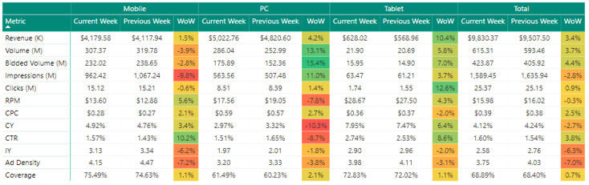
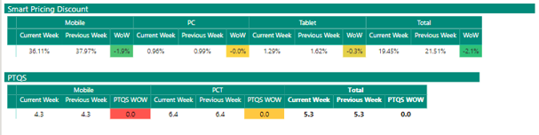
Bing Syndication US – FY 18 Week 38 (03/17 – 03/23)

Slide 35
Bing Syndication US Quality - FY17 Week 39 (03/24 – 03/30)
Market | PCT |  |  |  | Mobile
 | PTQS |  | SP Discount |  | PTQS |  | SP Discount
 | Week 39 | W/W | Week 39 | W/W | Week 39 | W/W | Week 39 | W/W
Bing O&O Core | 9.3 | 0.0 | 0.0% | 0.0% | 8.5 | -0.2 | 0.1% | 0.0%
Yahoo O&O Core | 8.9 | 0.0 | 0.0% | 0.0% | 5.7 | 0.4 | 14.6% | -0.3%
Bing Syndication* | 4.7 | 0.2 | 2.3% | 0.5% | 3.7 | 0.0 | 37.3% | -1.2%
Yahoo Syndication | 7.2 | 0.1 | 0.7% | 0.1% | 5.6 | -0.1 | 19.0% | 1.8%
AOL O&O | 9.7 | -0.2 | 0.0% | 0.0% | 7.6 | -0.1 | 0.1% | 0.1%
AOL SEM | 5.1 | -0.3 | 23.3% | -0.1% | 4.8 | -0.2 | 15.0% | 0.0%
CBSi | 5.8 | -0.5 | 1.4% | 0.2% | 5.6 | -0.5 | 15.4% | -2.0%
Infospace | 4.3 | 0.4 | 1.9% | 0.0% | 4.0 | 0.4 | 39.8% | -4.0%
OfferUp | 4.2 | -0.1 | 0.0% | 0.0% | 1.5 | 0.1 | 54.4% | 0.3%
Bing Overall | 9.1 | 0.0 | 0.5% | 0.0% | 5.4 | -0.1 | 20.0% | -1.1%
Smart Pricing Trends
PTQS Trends

